Slide 1
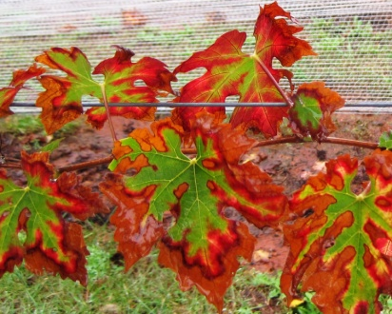
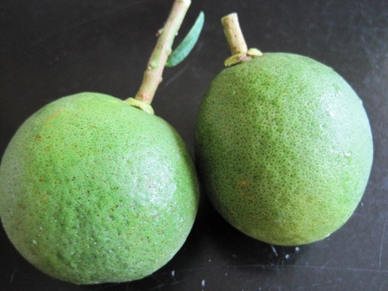
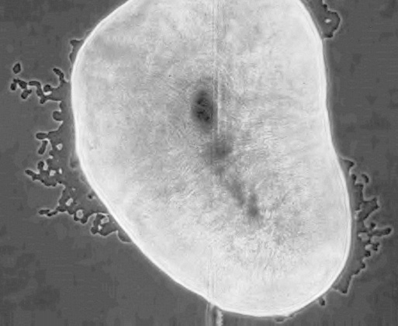
Undergraduate Internship in Plant Pathology
Internship:
An Undergraduate Internship in Plant Pathology is available for an undergraduate interested in assisting with laboratory research activities at Auburn University. Our plant pathology lab conducts research to understand the infection processes, survival/proliferation, and host preferences of bacterial phytopathogens that endanger agricultural crop production. The intern will assist with various aspects of ongoing research including bacterial isolation and culture from infected plant material, molecular characterization of bacterial isolates, greenhouse experiments, field sampling, assessment of biofilm formation in microfluidics experiments, and preparation of general laboratory supplies. If desired, the internship can be used for undergraduate research credit.
Requirements:
Must be working towards a B.Sc. in a relevant science-related major (e.g. Microbiology, Biology, Horticulture, etc.)
Interest in microbiology
Ability to communicate effectively
Commitment to work at least 8 hours per week
Preferred Qualifications:
Experience working in a research laboratory setting
Experience with aseptic technique
A cumulative GPA of 3.0 or higher
Ability to continue working in the lab over multiple semesters
Desire to continue with a career in scientific research
Contact:
Contact Leonardo De La Fuente at lzd0005@auburn.edu for further information. Please include a current CV with applicable qualifications and experience.
Lab website: http://www.ag.auburn.edu/enpl/directory/faculty/delafuente/lab/

